Slide 1
Integrated View for PDF Signing via REST API
Rachmawan Atmaji perdana
PEREKAYASA pertama (iii-b)

Slide 2
Background : Digital Certificate
A digital certificate is an electronic document that is used when communicating over the Internet, and allows you to confirm the identity of the sender. It contains a key which secures the exchange of information over the Internet.
Digital certificates prove the ownership of a public key and certificates are only issued by an authority, known as the certification authority (CA). Certification Authority are well established entity, for which the vetting of identity, required to deliver a certificate, are trusted.
https://www.justaskgemalto.com/en/what-is-a-digital-certificate/

Slide 3
Background : Digital Signature
A digital signature is a mathematical scheme for verifying the authenticity of digital messages or documents. A valid digital signature, where the prerequisites are satisfied, gives a recipient very strong reason to believe that the message was created by a known sender (authentication), and that the message was not altered in transit (integrity).

Slide 4
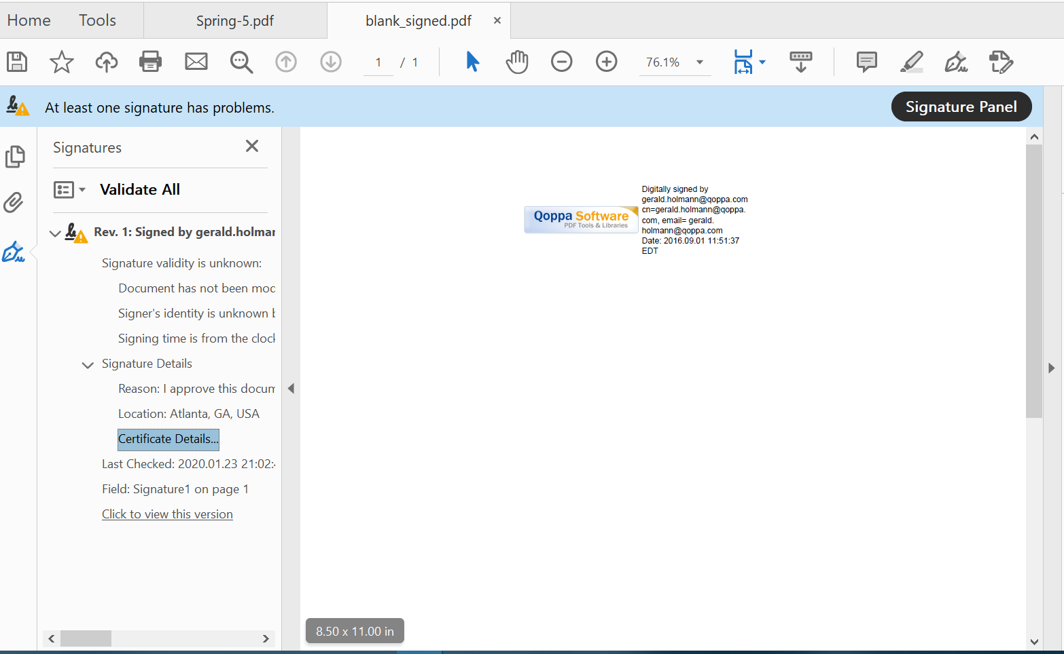
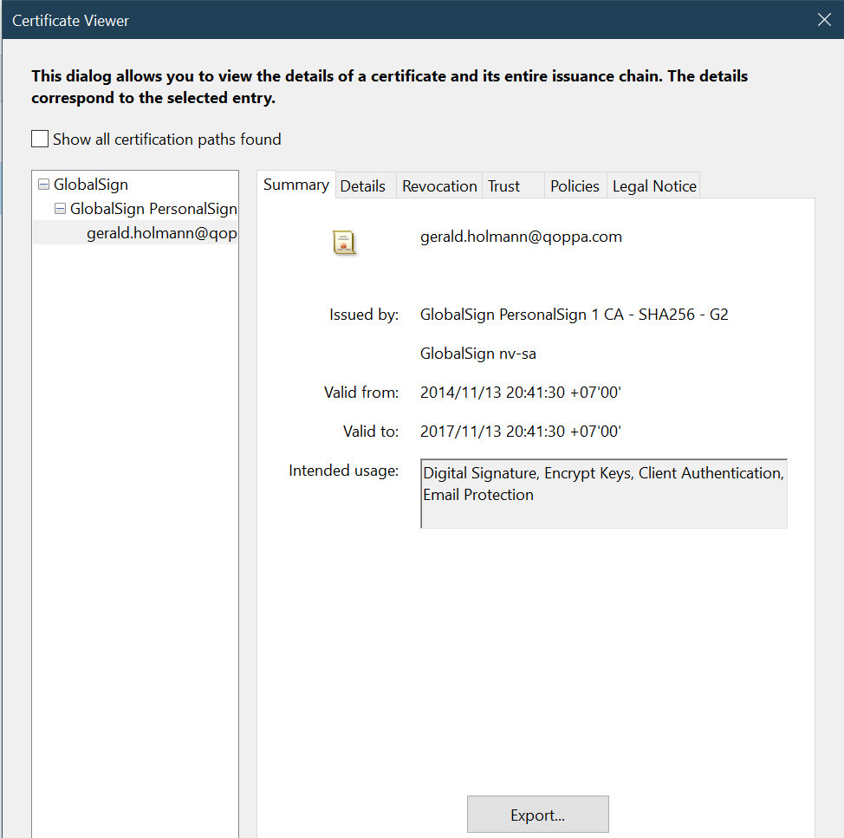
Background : Digital Signature in PDF File

Slide 5
iOTENTIK CA Business Model
User usually signed a PDF document using PDF Reader such as Adobe Acrobat. This process requires user to provide a digital identity or digital certificate.
The certificate, which had been created and published by iOTENTIK CA, cannot be obtained directly by users. Instead, it stored in CA’s Hardware Security Module (HSM)s. Thus, user cannot provide it to Adobe Acrobat.
Therefore, iOTENTIK provides user with an online PDF signing engine, which perform PDF signing on CA’s server. And then its result will be sent back to user.

Slide 6
Background : teken App
iOTENTIK-BPPT as CA had developed a PDF signing engine, communicating via REST API
This signing engine have to be integrated with teken App, which is a web application
For User Experience, teken App need some kind of previewing module for PDF document which will be signed using signing engine
URL : https://teken.bppt.go.id

Slide 7
Goals
Previewing PDF in-memory
Overlay signature image in PDF preview
User can make adjustment to signature image position and size
Should be able to communicate with signing API

Slide 8
Recipe
PDF.js
For previewing PDF
Konva.js
Overlay signature image
cURL (for communicating with API)

Slide 9

PDF.js
PDF.js is a Portable Document Format (PDF) viewer that is built with HTML5.
PDF.js is community-driven and supported by Mozilla Labs. The goal is to create a general-purpose, web standards-based platform for parsing and rendering PDFs.
Get PDF.js from :
https://cdnjs.com/libraries/pdf.js
https://cdnjs.com/libraries/pdf.js

Slide 10
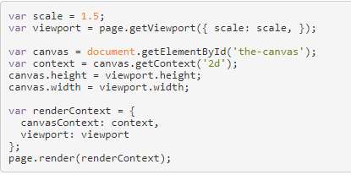
PDF.js – Render PDF
https://mozilla.github.io/pdf.js/examples/index.html#interactive-examples

Slide 11

Konva.js
Konva is an HTML5 Canvas JavaScript framework that extends the 2d context by enabling canvas interactivity for desktop and mobile applications.
Konva enables high performance animations, transitions, node nesting, layering, filtering, caching, event handling for desktop and mobile applications, and much more.
https://konvajs.org/docs/

Slide 12
Konva.js – Installation
Installing Konva using Package Managers :
npm install konva
Installing Konva using Script Tag :
<script src="https://unpkg.com/konva@4.0.0/konva.min.js"></script>

Slide 13
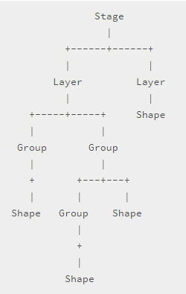
Konva.js – Overview
Konva.Stage contains several layers (Konva.Layer)
Each layer has two <canvas> renderers :
Scene Renderer
Hit Graph Renderer (hidden canvas for event detection)
Each layer can contain shapes, groups of shapes, or nested group
All of them are virtual nodes
We can bind listeners, transform nodes, run animations, apply filters to layers and shapes
https://konvajs.org/docs/overview.html

Slide 14
Konva.js – cont’d
Today we only need some features from Konva, namely Shape, Drag, and Transformation

Slide 15
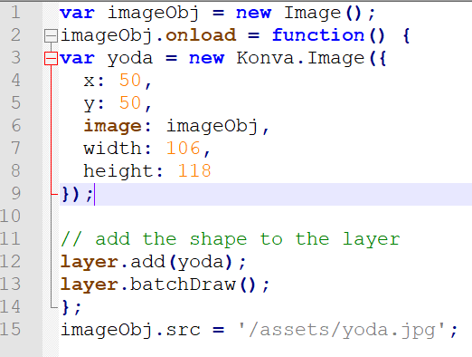
Konva.js – Image
To create an image with Konva, we can instantiate a Konva.Image() object with image property.

Slide 16
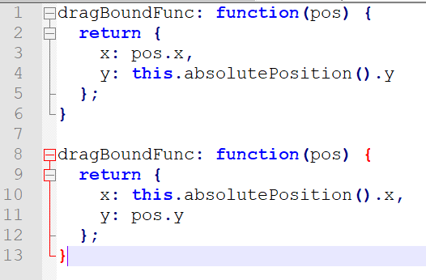
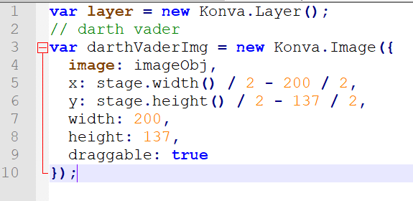
Konva.js – Drag and DragBound

Slide 17
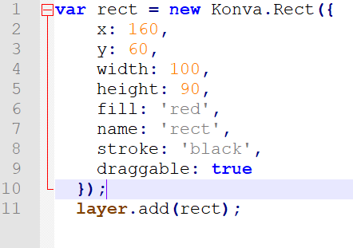
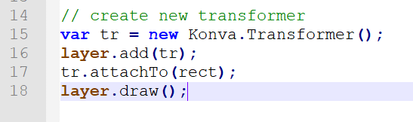
Konva.js – Transformation

Slide 18

Signing API - Specifications

Slide 19
LIVE CODING SESSION

Slide 20


Sharing is Communism Caring
Download this session’s Source Code :
https://github.com/WaOnEmperoR/pdf_preview
Don’t forget to give a star!

